Slide 1
Trans Fat Elimination
Trans Fat Free by 2023
Last updated 1/2020

Slide 2

What is Trans Fat?
‘The Tobacco of Nutrition’
Artificial compound added to food
Used in some countries in fried food, deep-fried food and baked goods, and spreads
Clogs arteries and causes heart attacks and death
Notes:
Trans fat is the tobacco of nutrition in that it has no health benefits and only health harms. Even a small amount can be harmful. Over time, it kills.
It’s also been a money-maker for the food industry, because it’s cheap, it extends shelf life of processed foods, and when used for deep frying, it doesn’t have to be changed as often as natural oils.

Slide 3


No One Asks for Trans Fat, and No One Will Miss it When it’s Gone
?
Added to food without consumers’ knowledge or consent
Has been estimated to kill more than 500,000 people each year (one death every minute)
More than 5 billion people live in countries without trans fat protections
(Wang et al., 2016)

Slide 4

Trans Fat Can Be Replaced
Only Your Heart Will Know the Difference
Trans fat can be replaced
Only your heart will know the difference
Notes:
Trans fat can easily be replaced in most foods with healthier oils without changing the taste or cost of food.

Slide 5



Eliminating Artificial Trans Fat is Feasible
Many governments have already successfully protected their people
Trans fat elimination is cost effective for low- and middle-income countries
Food companies have successfully replaced trans fat with healthier alternatives without harming business

Slide 6
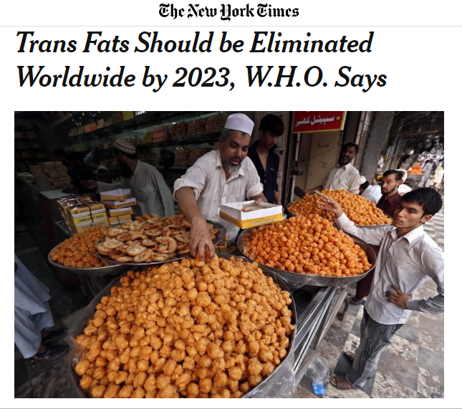

In 2018, WHO called for elimination of trans fat by 2023 and launched the REPLACE action package
Will be first elimination of a risk factor for non-communicable disease
Notes:
REPLACE is the compilation of lessons learned from countries that have successfully removed trans fat from food.
It provides six strategic action areas that countries can follow to see similar success, and make their citizens healthier.

Slide 7

Eliminating trans fat will save 17 million lives over 25 years
(Kontis et al., 2019)

Slide 8
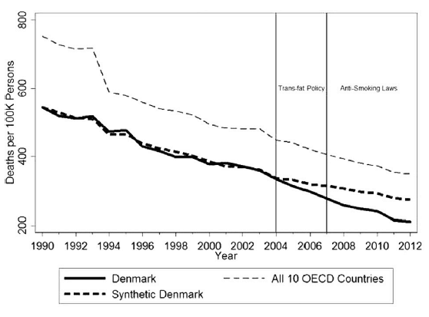
Heart disease deaths decreased by 10% relative to other similar countries
Denmark
(Restrepo et al., 2016)
Notes:
Denmark was the first country to regulate the content of trans fat in food products.
After the regulation was implemented (limit of 2% per total fat in all foods), deaths from coronary heart disease decreased by 10.4% relative to other similar countries.

Slide 9

Trans fat bans caused a 4.5% reduction in deaths from cardiovascular disease Counties with restrictions had a 7.2% greater decrease in hospital admissions for heart attacks than those without
New York State
(Restrepo et al., 2016; Brandt et al., 2017)
Mike Derer / AP file
Notes:
Switching to healthier alternatives did not increase cost of food, make food taste different, or prevent foods from being manufactured.

Slide 10
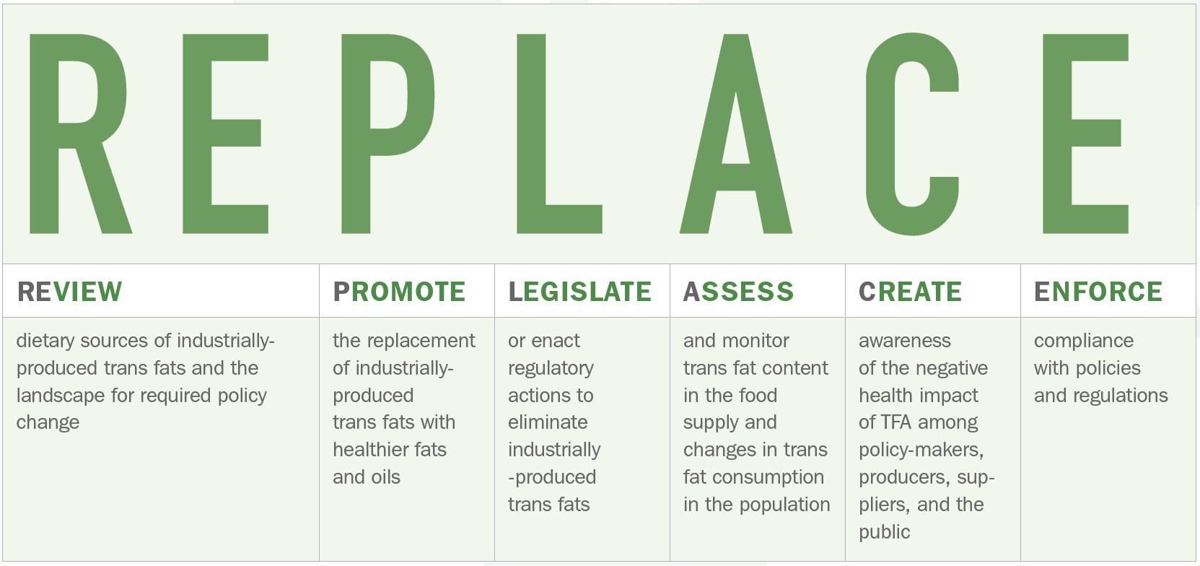

Slide 11



Mandatory national limit of 2 grams of industrial trans fat per 100 grams of total fat in all fats, oils and foods Mandatory national ban on the production or use of PHO as an ingredient in all foods
2 Paths to Elimination
Notes:
The most effective way to eliminate trans fat in the food supply is through regulatory action. But not all policies are equal.
According to WHO, there are two best practice policy models, and either fully protects people from artificial trans fat.

Slide 12

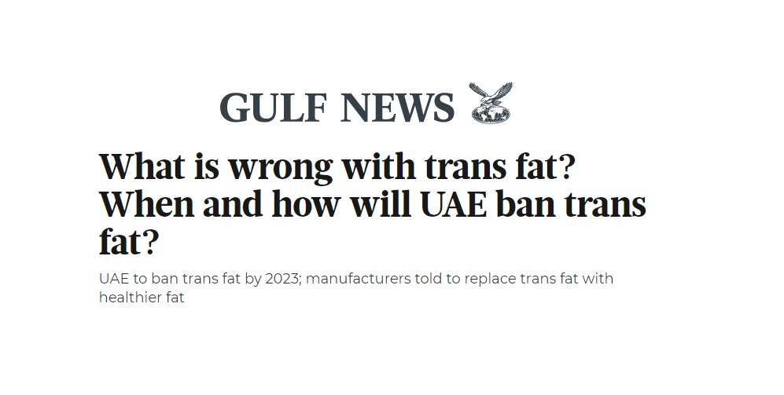
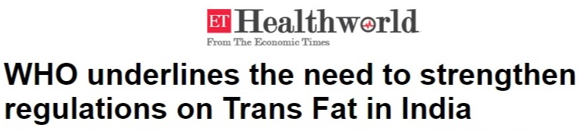
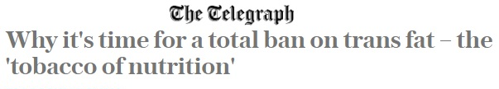
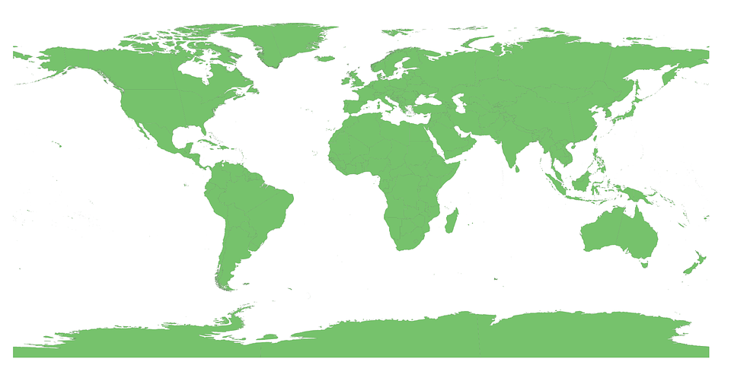
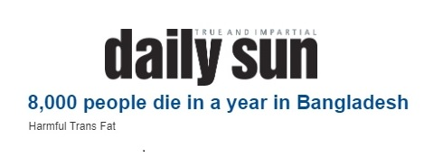
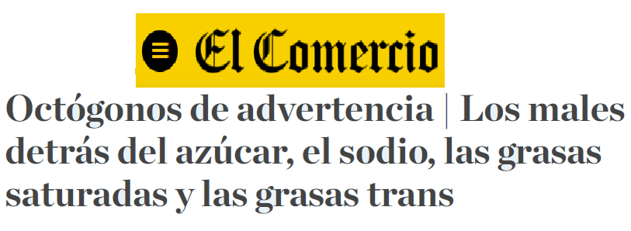
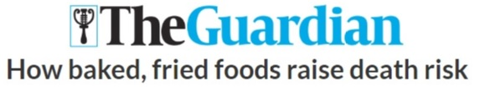

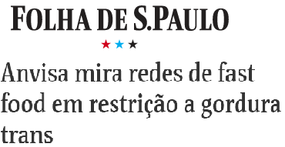

Slide 13
Global Trans Fat Elimination is Gaining Momentum
At this pace, global elimination is achievable by 2023
In 2021, trans fat limits go into effect in the European Union and Brazil
In 2015, Eurasian Economic Union countries limit trans fat
Denmark is the first country to limit artificial trans fat in 2003

Slide 14
Global Trans Fat Elimination is Gaining Momentum
Current global coverage (in millions)
7.7
Regulations are currently in effect for more than 2.4 billion people in 28 countries (31% global population coverage)
Since the beginning of 2018, limits have gone into effect in 6 additional countries and were passed in 25 additional countries
In 2019, countries in the Americas adopted a six-year plan to eliminate industrially-produced trans fat.
Regional regulations are in place in the Eurasian Economic Union, Gulf Cooperation Council, and the European Union More than 40 countries have begun activities to ban
No coverage
2.4
Some coverage
0.5
Best practice
0
0

Slide 15

1/3 of the World’s Population is Currently Protected by Mandatory TFA Limits
Best-practice TFA policies in effect (14 countries)
Best-practice TFA policy passed but not yet in effect (28 countries)
Less restrictive TFA limits (18 countries)
National policy commitment to eliminate TFA (50 countries)
Other complementary measures (25 countries)
Map accessed 8/28/2019: https://extranet.who.int/nutrition/gina/en/scorecard/TFA
Notes:
This live global map of trans fat policies is available on the WHO webpage, GINA: Global database on the Implementation of Nutrition Action

Slide 16
But Many Remain Unprotected
Countries with mandatory partially hydrogenated oil bans or trans fat limits passed or in effect, by income level
Most countries do not have policies in place to protect their citizens from trans fat
Two thirds of the world population is not protected from exposure
Most policy actions to date have been in higher-income countries and in the Americas and Europe
High Income
Upper Middle Income
Lower Middle Income
Low Income
Notes:
There is still a long way to go to achieve global elimination by 2023

Slide 17






Tools are Available to Support Countries to Take Action and Protect their People
Review
Promote
Legislate
Assess
Create
Enforce
Notes:
REPLACE includes implementation guides (or “modules”) for each action area and other tools to make it easy to implement the action areas, such surveillance protocols.
Tools and resources are available on the WHO REPLACE webpage.

Slide 18
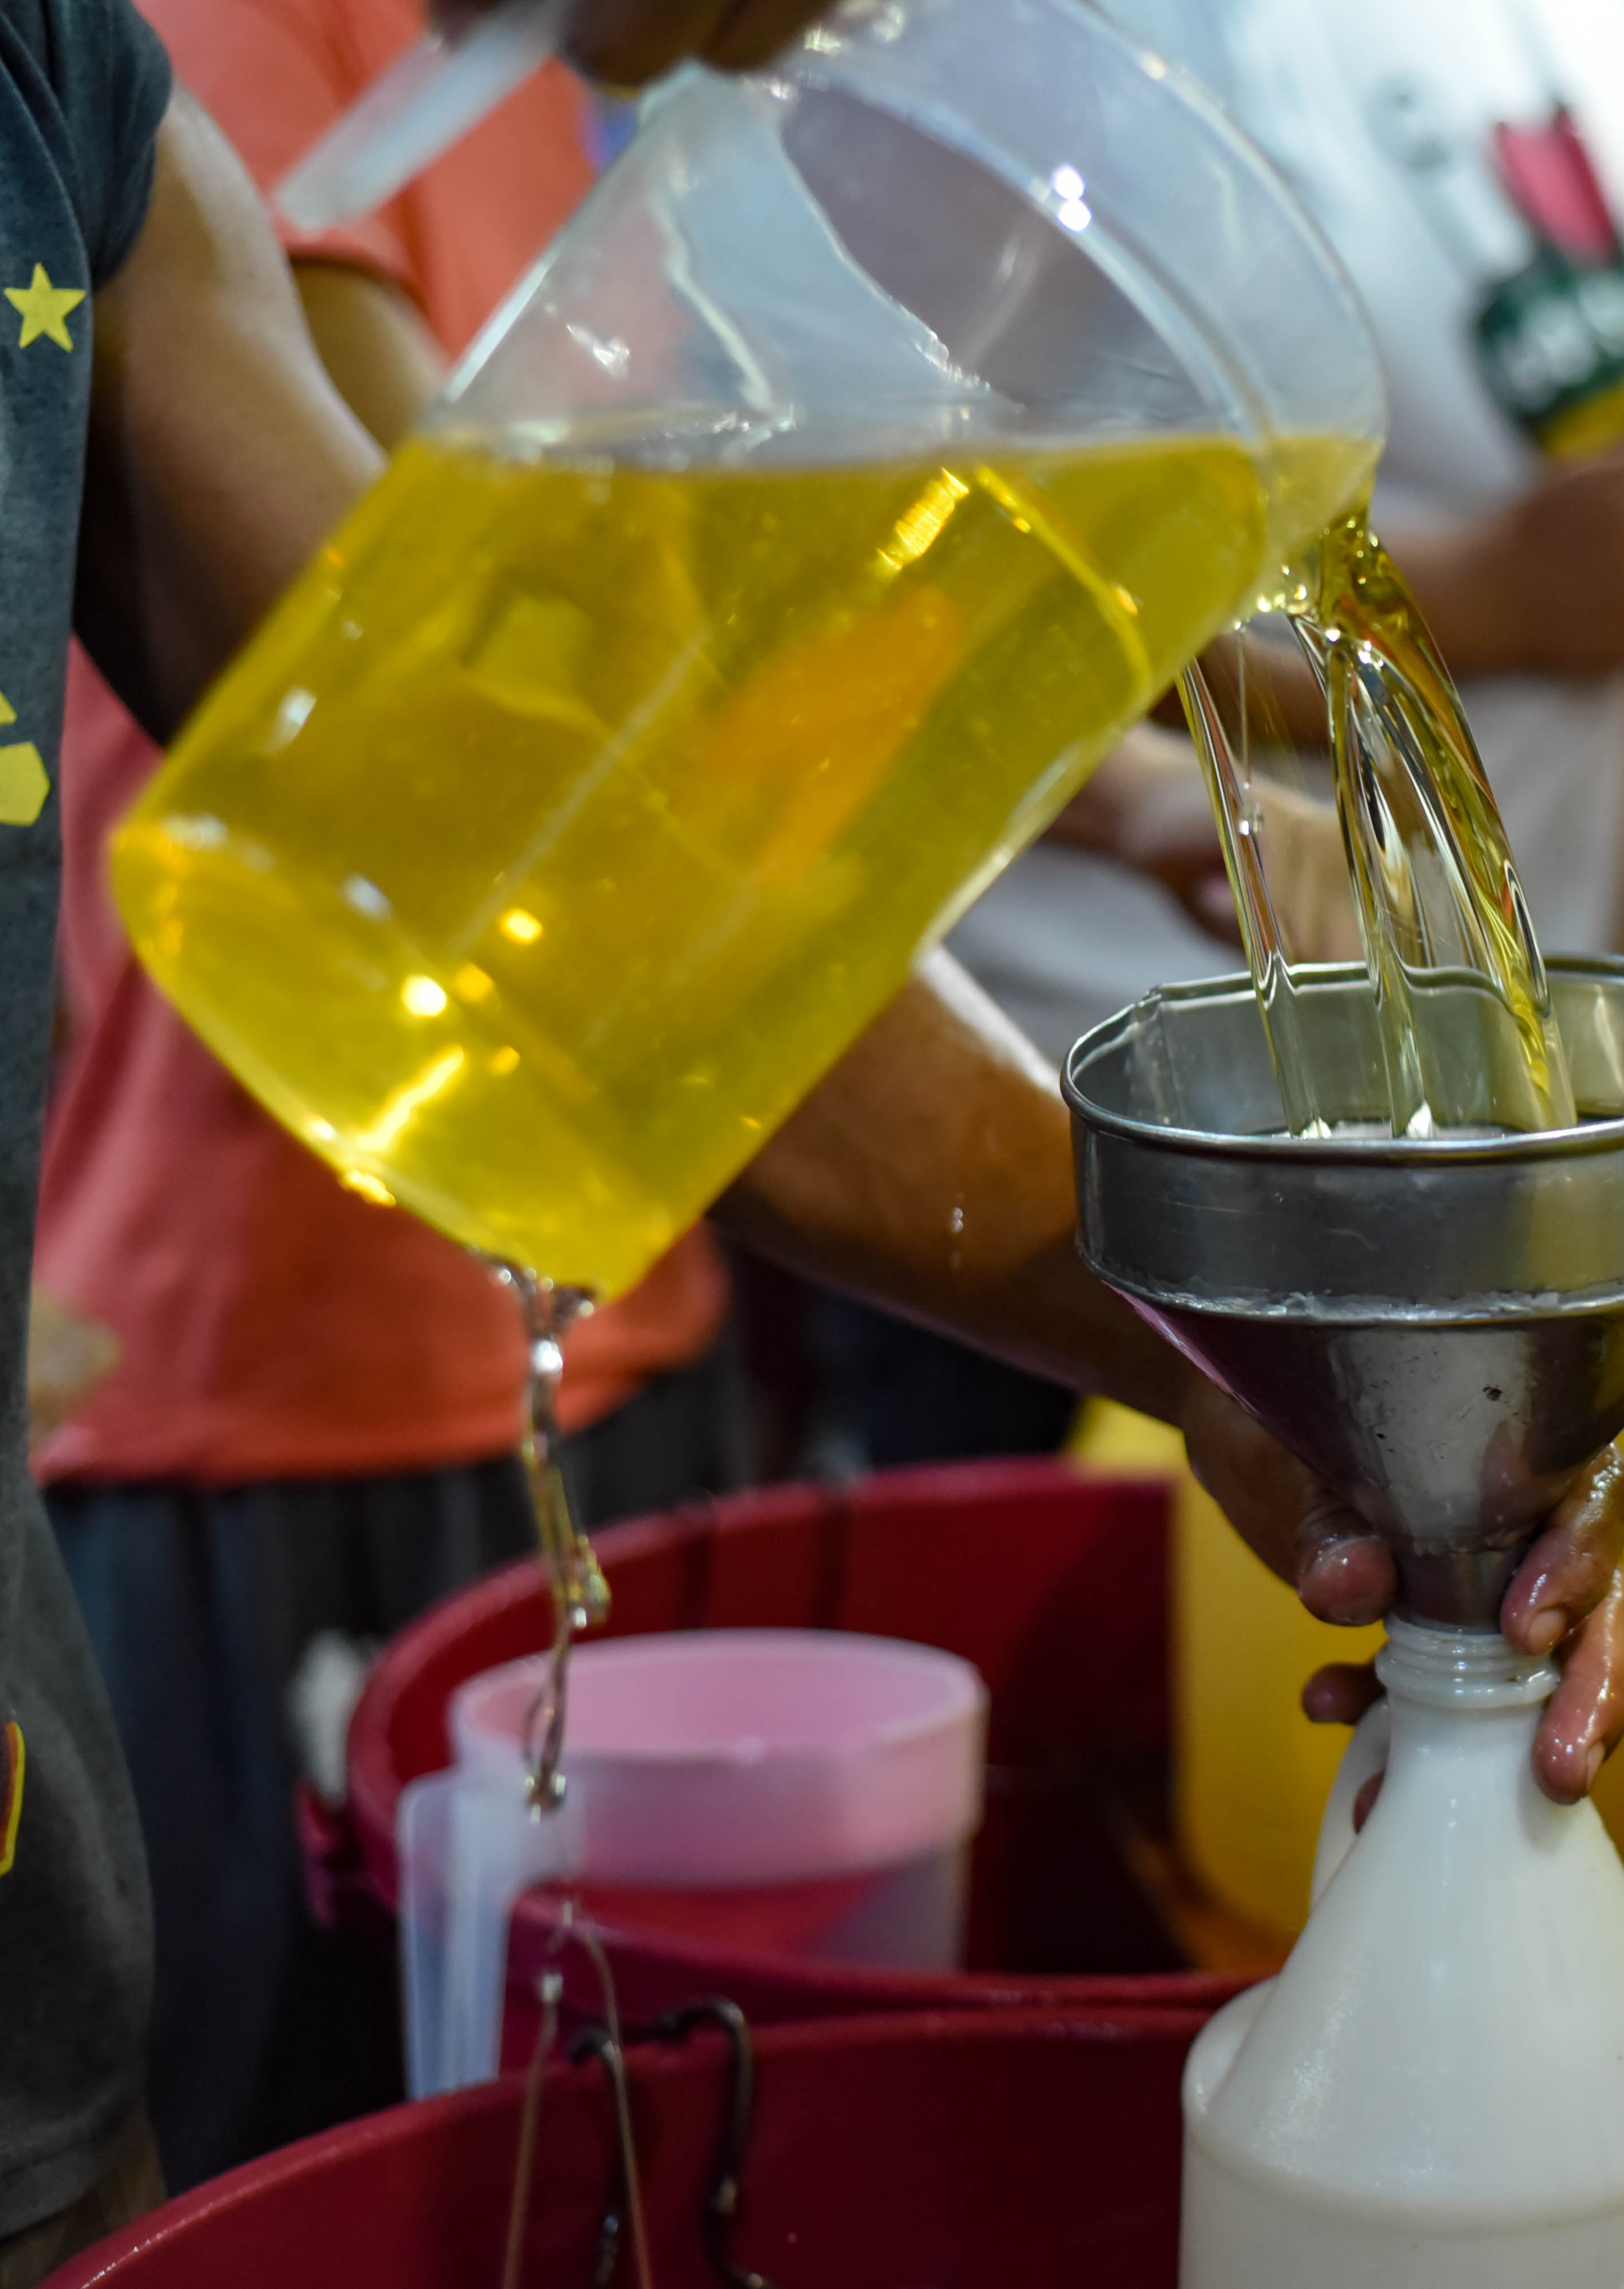
Bottom Line: the days of trans fat are numbered
All countries should implement best practice policies to eliminate artificial, industrially produced trans fat
All companies in the food, fats and oils industries must step up to protect the consumers of their products by replacing trans fat with healthy oils
Notes:
no child born anywhere in the world after 2023 will be at risk of being exposed to this harmful and unnecessary toxic chemical.

Slide 19
Learn More
WHO REPLACE Action Package: https://www.who.int/nutrition/topics/replace-transfat/
WHO Trans Fat Country Policy Scorecard: https://extranet.who.int/nutrition/gina/en/scorecard/TFA
Resolve to Save Lives: https://www.resolvetosavelives.org/transfat/
LINKS Toolkit: https://www.linkscommunity.org/toolkit/#transfat
NCD Alliance: https://ncdalliance.org/resources/transfatfree2023report

Slide 20
References
Wang, Q., Afshin, A., Yakoob, M. Y., Singh, G. M., Rehm, C. D., Khatibzadeh, S., ... & Mozaffarian, D. (2016). Impact of nonoptimal intakes of saturated, polyunsaturated, and trans fat on global burdens of coronary heart disease. Journal of the American Heart Association, 5(1), e002891.
Kontis, V., Cobb, L. K., Mathers, C. D., Frieden, T. R., Ezzati, M., & Danaei, G. (2019). Three Public Health Interventions Could Save 94 Million Lives in 25 Years Global Impact Assessment Analysis. Circulation.
Restrepo, B. J., & Rieger, M. (2016). Denmark’s policy on artificial trans fat and cardiovascular disease. American journal of preventive medicine, 50(1), 69-76.
Restrepo, B. J., & Rieger, M. (2016). Trans fat and cardiovascular disease mortality: evidence from bans in restaurants in New York. Journal of health economics, 45, 176-196.
Brandt, E. J., Myerson, R., Perraillon, M. C., & Polonsky, T. S. (2017). Hospital admissions for myocardial infarction and stroke before and after the trans-fatty acid restrictions in New York. JAMA cardiology, 2(6), 627-634.

